Slide 1
Unit Testing with JUnit
And other xUnit type software
\
Notes:
Made by jenelle! Not licensed under creative commons, mit, or any other open source attribution!

Slide 2
Topics
What is Junit
How to use Junit
Translating test cases into JUnit code
Code coverage with ECLEmma

Slide 3
Why do we test?
To prove to yourself and your customers that your code works.
More info - see slide from week 1:
https://docs.google.com/presentation/d/1Y49trzU3CL48CpkIQ_RY3eN8PLo2mNWe9ocv3ohbyes/edit

Slide 4
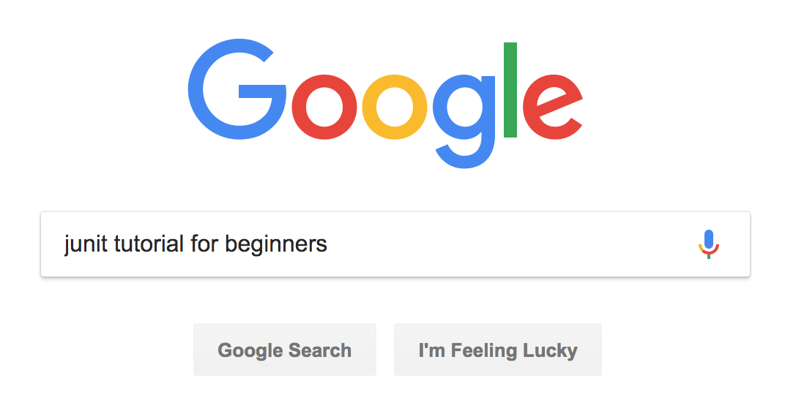
Tutorials and Resources for JUnit

Slide 5
Tutorials and Resources on JUnit
Is typing “JUnit” into Google too difficult? If yes, here are some resources:
Youtube:
JUnit in 28 minutes: https://www.youtube.com/watch?v=bdc5WbKKbK4
JUnit in 11 minutes: https://www.youtube.com/watch?v=I8XXfgF9GSc
Websites:
TutorialsPoint: https://www.tutorialspoint.com/junit/junit_api.htm
JUnit E-book: http://enos.itcollege.ee/~jpoial/allalaadimised/reading/JUnit-Tutorial.pdf

Slide 6
What is JUnit? (or xUnit)
xUnit = software tools for creating automated test cases
xUnit is available in almost every programming language
If you understand how to use one type of xUnit, you will understand the others.
Programming Languages | Name of xUnit software
Java | JUnit
Javascript | JSUnit
Python | pyUnit
Swift | xcTest

Slide 7
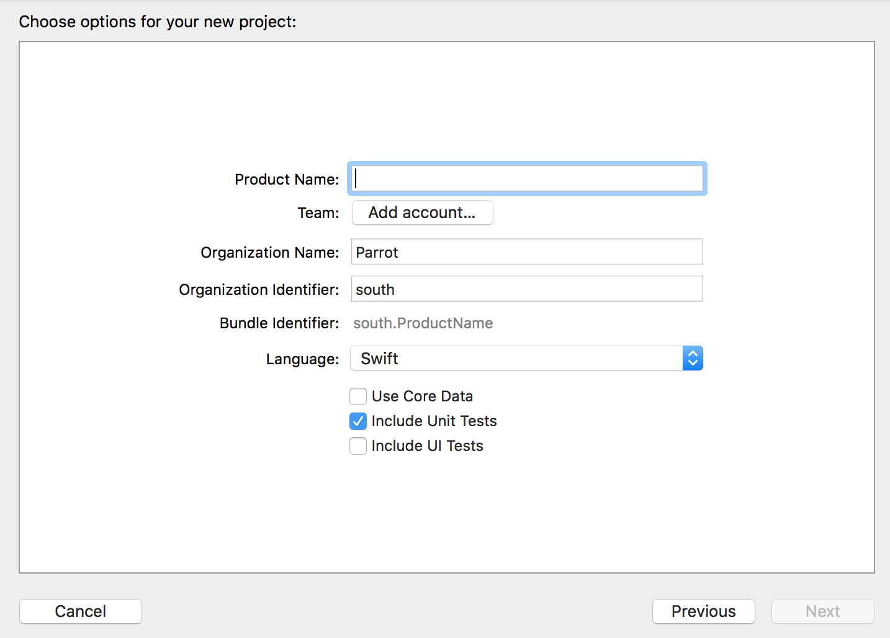
How to unit test IOS apps
XCode comes with it’s own unit testing software.
It’s called xcTest.
The syntax is similar to JUnit, except all the functions are written in Swift.
More info: https://www.hackingwithswift.com/read/39/2/creating-our-first-unit-test-using-xctest

Slide 8
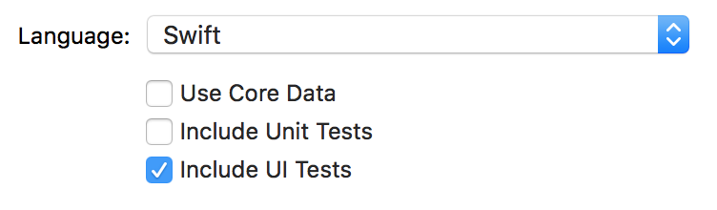
Testing Apps
When testing a mobile app, you divide tests into:
Unit tests → today’s lecture!
UI tests → testing the user interface
For UI tests, use these softwares:
Android: Espresso
XCode:
Web: Selenium
https://www.swiftbysundell.com/posts/getting-started-with-xcode-ui-testing-in-swift

Slide 9
How to use JUnit

Slide 10
Assertions
Unit tests are based on assertions
Assertions: built in functions that check if your input meets a certain condition
Examples of assertions:
assertEquals(a,b) | Check if a = b (a and b are same value)
assertTrue(a) | Check if a == true
assertNull(a) | Check if a == null
fail(“mmmm”) | Purposely causes a test to fail. After failing, print “mmmm” to the screen.
* Note: Above functions are from JUnit, but all the xUnit software has similarly named functions

Slide 11
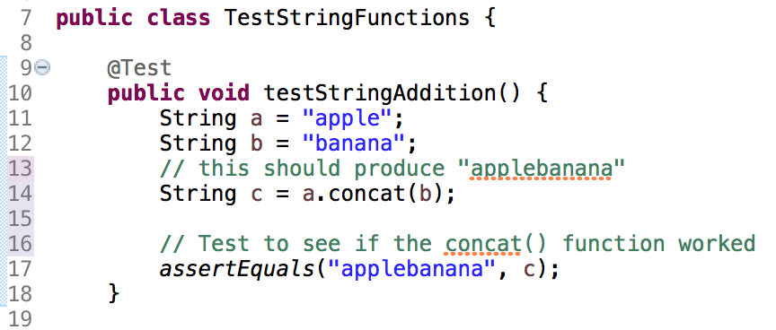
What a JUnit Test Looks Like
A JUnit test file looks like this:

Slide 12
What does it mean?
Put your test cases into a separate class!
Tells Eclipse you want this function to run as a TEST
This function checks if
c == “applebanana”.
If yes, test passes. If no, test fails.

Slide 13
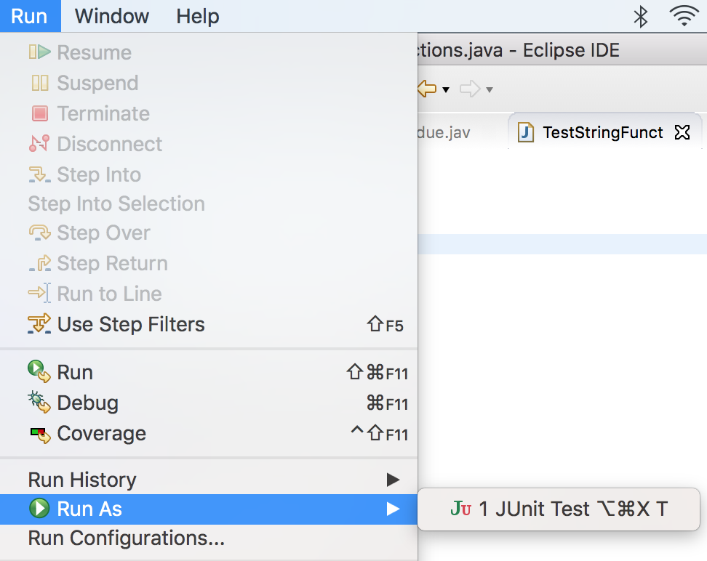
Running the Test
To run a test in Eclipse:
Select your class that contains the test cases
Choose:
Run As > JUnit Test
3. Look at the results

Slide 14
How to create JUnit Tests
Install JUnit into your IDE
If you are using Eclipse, you can skip this step.
JUnit is automatically installed with Eclipse.
Add a new JUnit Class to your project
Add a JUnit Test to the class
Run the test
If test passes, good
If test fails, write code to fix the error

Slide 15
Writing JUnit Tests

Slide 16
How to write a JUnit Test?
To write a test, you need to know:
The use case
The scenarios
After getting this information, you convert the use case and scenarios into code.
What does the code look like?
Use Case = JUnit Class file
Scenarios = @Test functions inside the JUnit Class file.

Slide 17
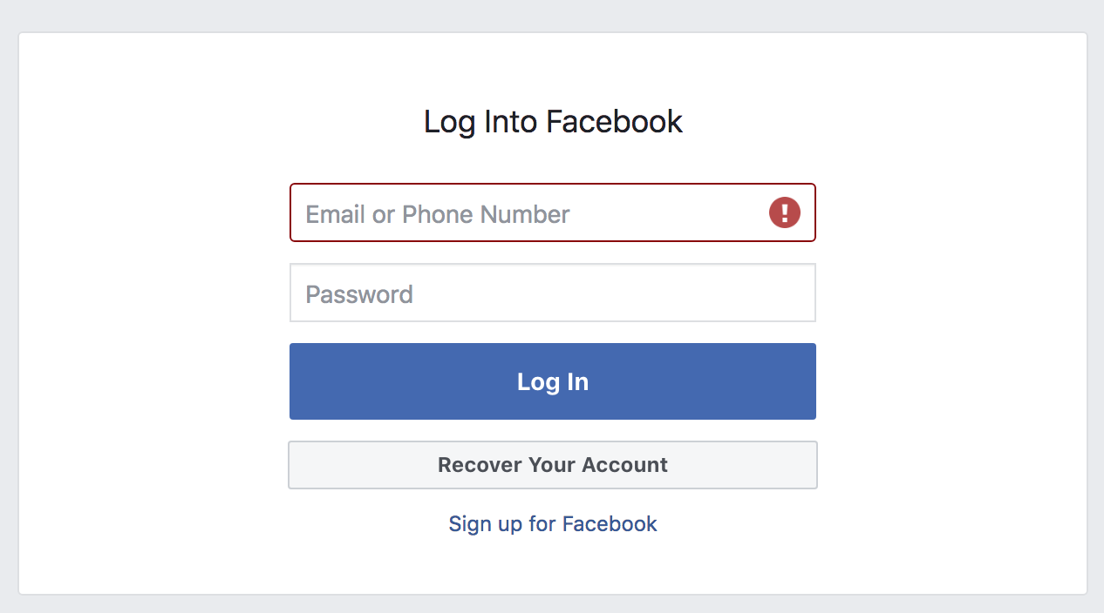
Example of a Use Case and Scenario
You work for Facebook. Your job is to test the Facebook login page.

Slide 18
What is the Use Case and Scenarios?
Use Case:
The user can log into the Facebook webpage.
Scenario 1: User enter a correct username/password
User enters a valid email and password
User presses the LOG IN button
System responds by redirecting user to the Home screen.

Slide 19
Use Cases & Scenarios, continued
Scenario 2: User enters a wrong email or password
User enters the correct email
User enters wrong password
User pressed LOG IN button
System should respond by showing an error message
Scenario 3: User is missing a email/password
User leaves email or password field blank
User presses LOG IN button
System responds by showing an error message.

Slide 20
How do I convert the scenario/use case to code?
Remember:
Use Case = JUnit Class file
Scenarios = @Test functions inside the JUnit Class file.
Each JUnit class file represents ONE use case
Inside the JUnit class, you can have many functions. Each function represents ONE scenario.

Slide 21
Structure of a JUnit Class
Class
Represents 1 use case
Function
Represents 1 scenario in the use case
Inheritance
Sometimes, your test classes will need to share information.
Use class inheritance to share information.

Slide 22
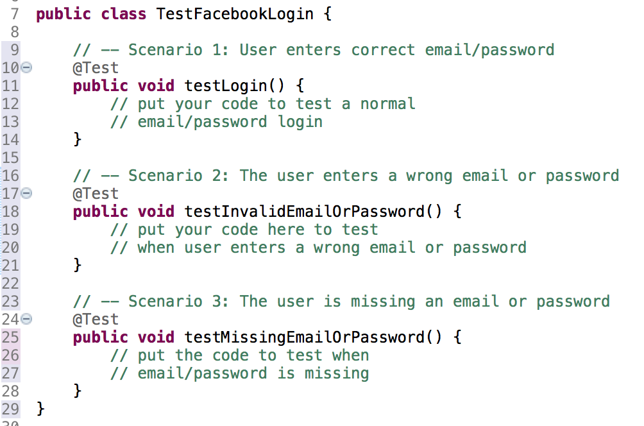
Example - Testing Facebook Login use case

Slide 23
Example:
import static org.junit.Assert.*;
public class UseCaseName {
@Test
public void scenario1() {
...
}
@Test
public void scenario2() throws Exception {
...
}
}

Slide 24
Other JUnit Functions
Fail
assertTrue
assertFalse
assertEquals

Slide 25
Testing Exceptions

Slide 26
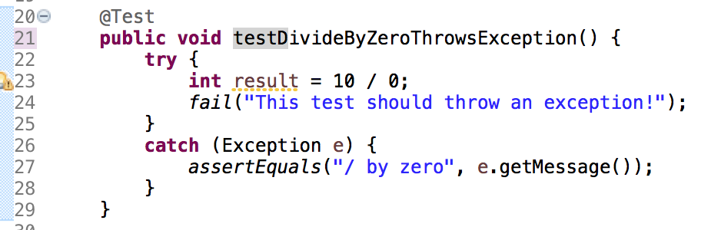
Testing for Exceptions
You may want to test if your code throws Exceptions properly.
Example: The code tries to divide a number by zero. This should produce an exception. (in math, you cannot divide numbers by zero)

Slide 27
Exceptions - Code Breakdown:
Put a fail() condition in the try block
If the fail() runs, then your Exception did NOT get thrown.
Use a try-catch block
OPTIONAL: Check if the exception contains the correct message.
You can also put nothing in the catch() block.

Slide 28
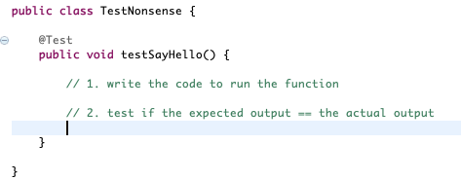

Slide 29
Failures vs. Errors

Slide 30
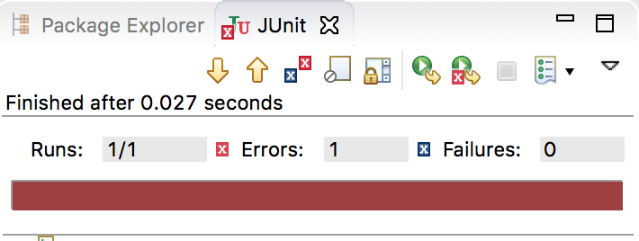
Failures vs. Errors
What’s the difference?

Slide 31
JUnit - Errors vs. Failures
See here:
https://docs.google.com/document/d/1bDF8sfTf4ymY53Cpl8Rkmx2bL7HAlgTboVYlhT-K0-w/edit#heading=h.casxyslihkb

Slide 32
Code Coverage

Slide 33
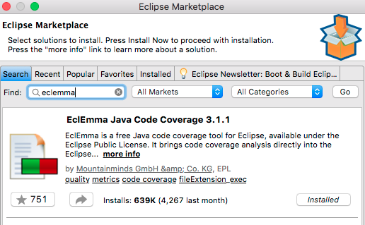
Automating Code Coverage Test
Code Coverage Tests with EclEmma
EclEmma is installed by default on the latest versions of the Eclipse IDE (version: 2018-12 (4.10.0))
Check if it is installed like this:
Go to Help > Eclipse Marketplace
Search for EclEmma
Check if your system shows Installed
If not installed, then install it!

Slide 34
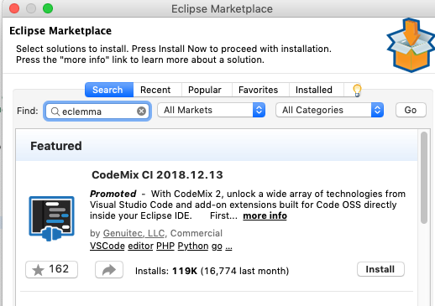

Slide 35
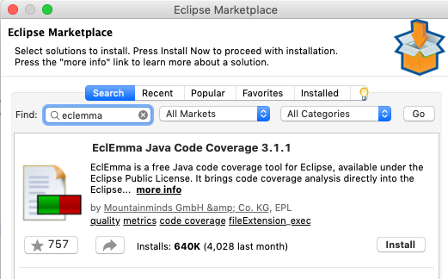

Slide 36
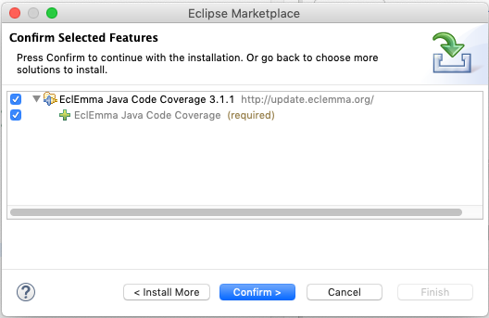

Slide 37
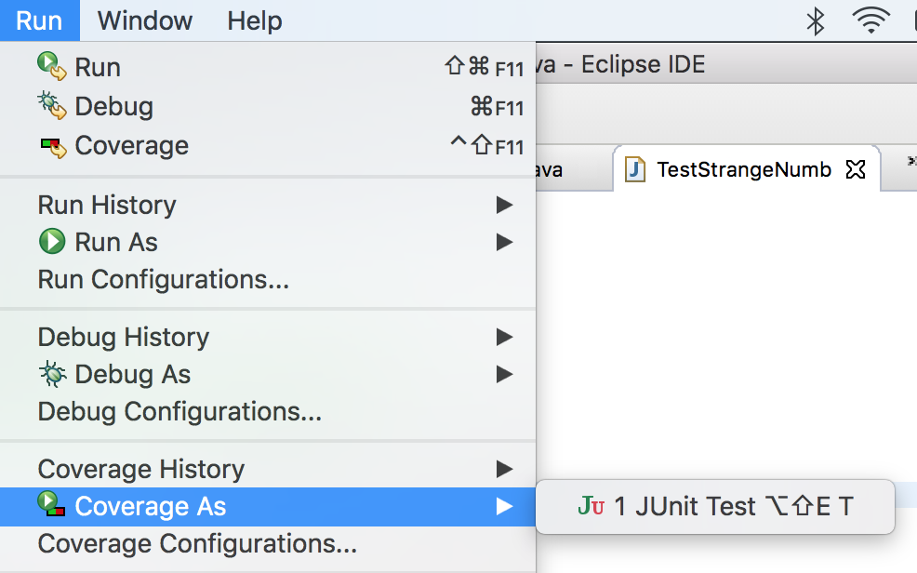
How to run a coverage test

Slide 38
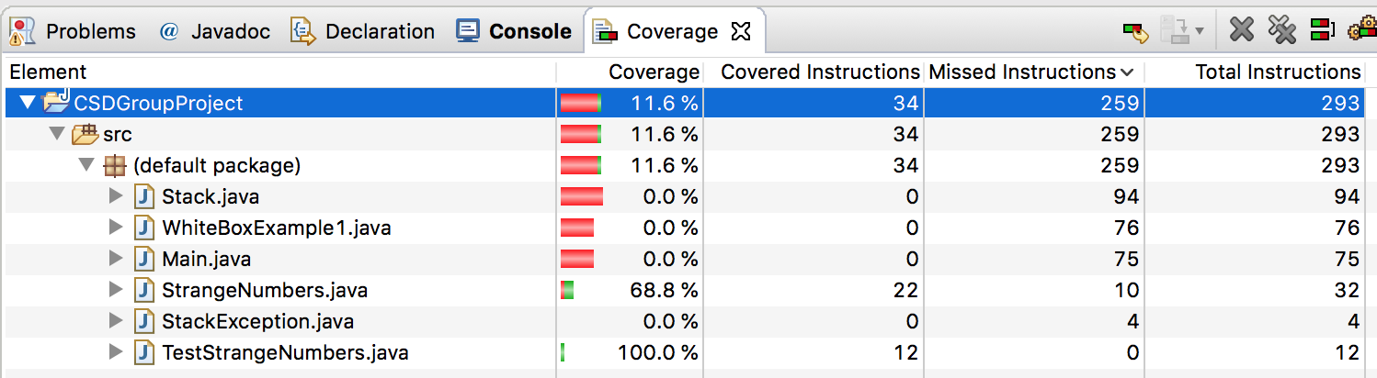
Look at results
Meaning: Your test cases only cover 68.8% of the code.

Slide 39
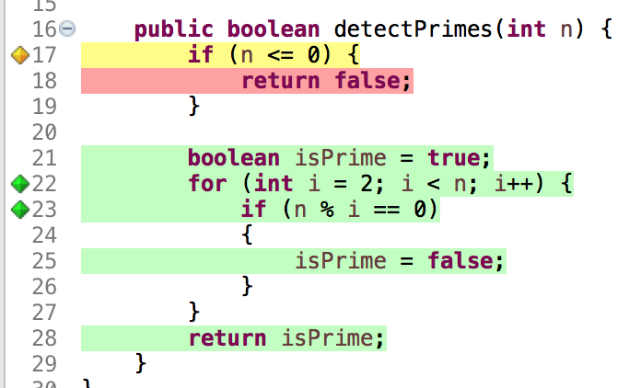
Go to the file
Code NOT tested!
Green = code was tested
Yellow = a condition
Red = code not tested
Code was tested!

Slide 40
How much code coverage should I get?
80% coverage is good.
(obviously more is better!)

Slide 41
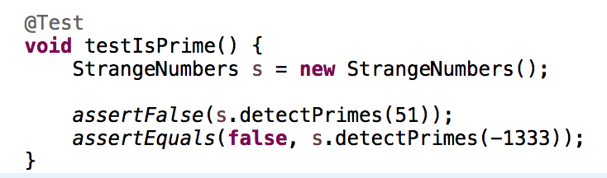
How to increase code coverage?
Write tests that exercise the untested code!
Make new cases based on statement coverage // equivalence classes // BVA techniques!

Slide 42
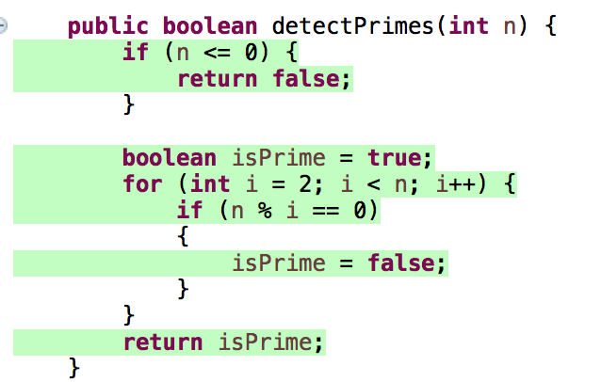
The result?
100% coverage, yay!

Slide 43
Summary

Slide 44
Summary
JUnit (and other xUnit software) is used for automating unit tests
JUnit is based on assertion functions → these are functions which test for specific conditions
There are many different assertion functions (click here for more examples)
You make a JUnit test by converting your use case and scenarios into code
A use case = class and scenario = functions inside the class
Run a JUnit test by clicking on Run As > JUnit Test
Test for code coverage using ECLEmma software

